Slide 1

CSE 411: Artificial Intelligence
Topic – 3: Solving Problems by Searching
Department of CSE
Daffodil International University
Notes:
‹#›

Slide 2
Topic Contents
Problem Solving Agents
Problem Formulation and Search Spaces
Example Problems
Tree Search Algorithm
    Breadth-First Search
    Uniform-Cost Search
    Depth-First Search
    Depth-Limited Search
    Iteratively Deepening Search
    Bidirectional Search
‹#›

Slide 3

Introduction
In this topic, we see how an agent can find a sequence of actions that achieves its goals, when no single action will do.
‹#›

Slide 4
Problem-Solving Agent
Four general steps in problem solving:
Goal formulation
  What are the successful world states
Problem formulation
  What actions and states to consider given the goal
Search
  Examine different possible sequences of actions that lead to states of known value and then choose the best sequence
Execute
  Perform actions on the basis of the solution
‹#›

Slide 5
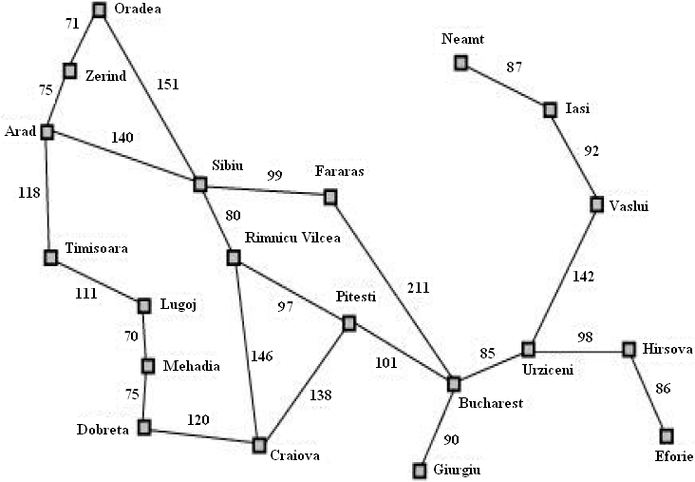
Example: Romania
‹#›

Slide 6
Example: Romania
On holiday the agent is in Romania visiting in Arad. Flight leaves tomorrow from Bucharest.
Formulate goal
  Be in Bucharest
Formulate problem
  States: various cities
  Actions: drive between cities
Find solution
  Sequence of cities; e.g. Arad, Sibiu, Fagaras, Bucharest,…
‹#›

Slide 7
Problem Type
Given how we have defined the problem:
Environment is fully observable
Environment is deterministic
Environment is sequential
Environment is static
Environment is discrete
Environment is single-agent
‹#›

Slide 8
Problem Formulation
A problem is defined by:
  An initial state, e.g. In(Arad)
  A successor function S(x) = set of action-state pairs
    S(In(Arad)) = {(Go(Sibiu), In(Sibiu)), (Go(Zerind), In(Zerind)), (Go(Timisoara), In(Timisoara))}
    initial state + successor function = state space
  Goal test
    Explicit, e.g. x=‘In(Bucharest)’
  Path cost (assume additive)
    e.g. sum of distances, number of actions executed, …
A solution is a sequence of actions from initial to goal state
  the optimal solution has the lowest path cost
‹#›

Slide 9
State Space
The state space of a problem is the set of all states reachable from the initial state.
The state space forms a graph, called a state space graph, in which the nodes are states and the arcs (may be labeled with costs) between nodes are actions.
The map of Romania shown in an earlier slide can be interpreted as a state space graph if we view each road as standing for two driving actions, one in each direction.
‹#›

Slide 10
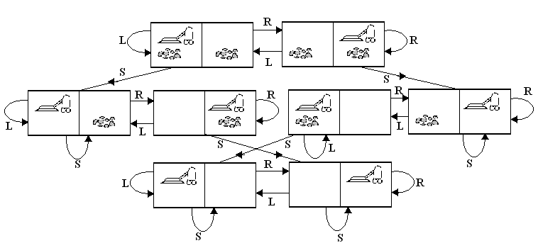
State Space
State space of the vacuum world
‹#›

Slide 11
Example Problems
The problem-solving approach has been applied to a vast array of task environments.
Some of the best known are listed here, distinguishing between toy and real-world problems.
A toy problem is intended to illustrate or exercise various problem-solving methods.
It is usable by different researchers to compare the performance of algorithms.
A real-world problem is one whose solutions people actually care about.
We will mainly focus on toy problems in this topic.
‹#›

Slide 12
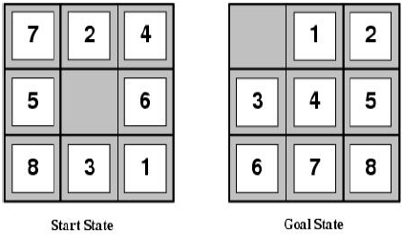
Toy Problems: 8-Puzzle
States: location of each tile plus blank
Initial state: Any state can be initial
Actions: Move blank {Left, Right, Up, Down}
Goal test: Check whether goal configuration is reached
Path cost: Number of actions to reach goal
‹#›

Slide 13
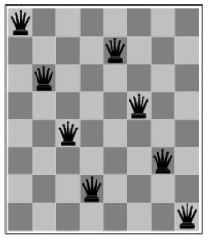
Toy Problems: 8-Queens
Place eight queens on a chessboard such that no queen attacks any other.
Two kinds of problem formulation:
Complete-state formulation
Incremental formulation
‹#›

Slide 14
Toy Problems: 8-Queens
Complete-state formulation
States: Any arrangement of 0 to 8 queens on the board
Initial state: No queens
Actions: Add queen to any empty square
Goal test: 8 queens on board and none attacked
Path cost: N/A
64.63.62…..57 ≈ 3 x 10¹⁴ possible sequences to investigate
‹#›

Slide 15
Toy Problems: 8-Queens
Incremental formulation
States: n (0 to 8) queens on the board, one per column in the n leftmost columns with no queen attacking any other
Actions: Add queen in leftmost empty column such that the queen is not attacking any other queen
2057 possible sequences to investigate; solutions are easy to find
But with 100 queens the problem is much harder
‹#›

Slide 16
Real-World Problems
Route-finding problems
Touring problems
Traveling Salesman problem
VLSI layout problem
Robot navigation
Automatic assembly sequencing
Internet searching
‹#›

Slide 17
Basic Search Algorithms
How do we find the solutions of previous problems?
Search the state space
  State space can be represented by a search tree
  Root of the tree is the initial state
  Children generated through successor function
In general we may have a search graph rather than tree (same state can be reached through multiple paths)
‹#›

Slide 18

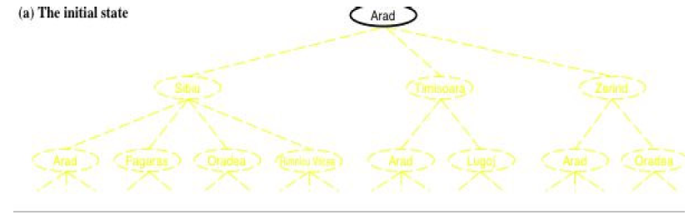
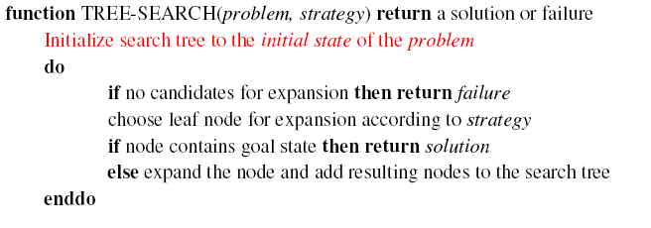
Simple Tree Search Example
‹#›

Slide 19
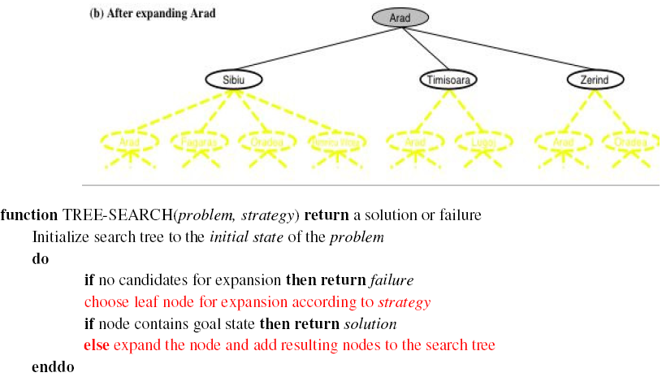
Simple Tree Search Example
‹#›

Slide 20
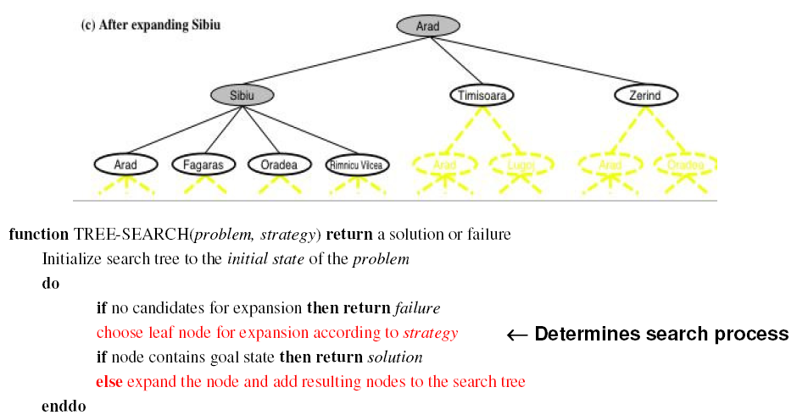
Simple Tree Search Example
‹#›

Slide 21
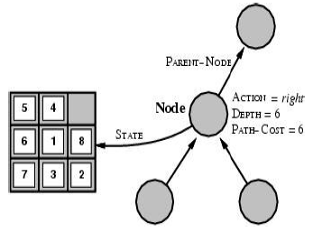
State Space vs. Search Tree
A state corresponds to a configuration of the world
A node is a data structure in a search tree
  e.g. node = <state, parent-node, action, path-cost, depth>
‹#›

Slide 22
Search Strategies
A search strategy is defined by picking the order of node expansion
Problem-solving performance is measured in four ways:
  Completeness: Is a solution found if one exists?
  Optimality: Does the strategy find the optimal solution?
  Time Complexity: How long does it take to find a solution?
  Space Complexity: How much memory is needed to perform the search?
Time and space complexity are measured in terms of problem difficulty defined by:
    b - branching factor of the search tree
    d - depth of the shallowest goal node
    m - maximum length of any path in the state space
‹#›

Slide 23

Uninformed Search Strategies
Uninformed search (or blind search)
  Strategies have no additional information about states beyond that provided in the problem definition
Uninformed strategies (defined by order in which nodes are expanded):
  Breadth-first search
  Uniform-cost search
  Depth-first search
  Depth-limited search
  Iterative deepening search
  Bidirectional search
‹#›

Slide 24
Informed Search Strategies
Informed (or heuristic) search
  Search strategies know whether one state is more promising than another
Examples of informed search strategies:
  Greedy best-first search
  A* search
  Iterative-deepening A* (IDA*) search
  Recursive best-first search (RBFS)
  Memory-bounded A* (MA*) search
  Simplified memory-bounded A* (SMA*) search
‹#›

Slide 25
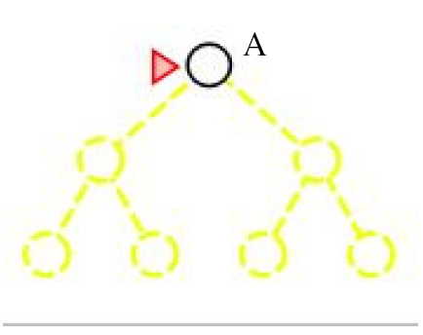
Breadth-First Search
Expand shallowest unexpanded node
Fringe is the collection of nodes that have been generated but not yet expanded.
The set of all leaf nodes available for expansion at any given point is called the frontier.
Implementation: fringe/frontier is a FIFO queue
‹#›

Slide 26
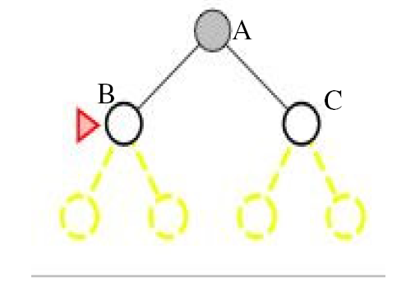
Breadth-First Search
‹#›

Slide 27
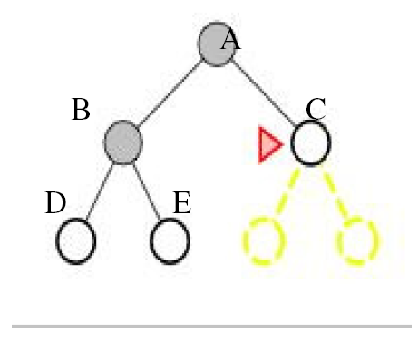
Breadth-First Search
‹#›

Slide 28
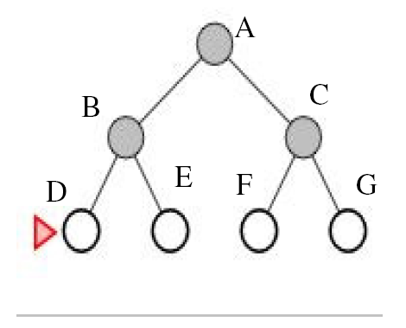
Breadth-First Search
‹#›

Slide 29
Breadth-First Search
Completeness: is a solution always found if one exists?
  YES
    If shallowest goal node is at some finite depth d
    If branching factor b is finite
BF search is optimal if the path cost is a non-decreasing function of the depth of the node
‹#›

Slide 30
Breadth-First Search
Time complexity: Assume a state space where every state has b successors
  Assume solution is at depth d
  Worst case: expand all but the last node at depth d
  Total number of nodes generated:
  b + b² + b³ + ...+ b^{d} + (b^{d +1}− b) = O(b^{d +1})
Space complexity: every node generated must remain in memory, so same as time complexity
‹#›

Slide 31
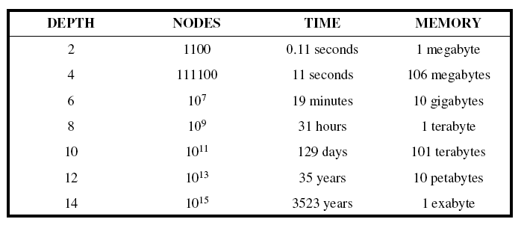
Breadth-First Search
Memory requirements are a bigger problem than execution time.
‹#›

Slide 32
Uniform-Cost Search
Extension of BF-search:
  Expand node with lowest path cost
Implementation: fringe = queue ordered by path cost
UC-search is the same as BF-search when all step costs are equal
‹#›

Slide 33
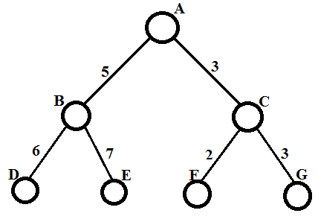
Uniform-Cost Search
Let us consider the following search tree, where A and G are the initial and goal node, respectively.
‹#›

Slide 34
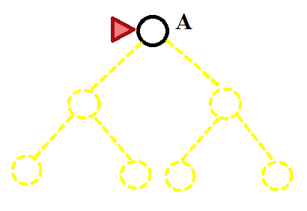
Uniform-Cost Search
‹#›

Slide 35
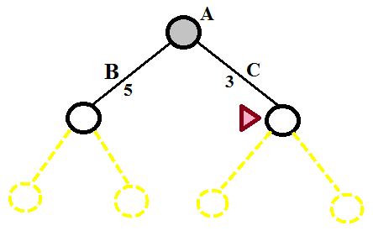
Uniform-Cost Search
‹#›

Slide 36
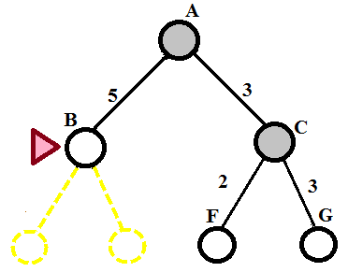
Uniform-Cost Search
‹#›

Slide 37
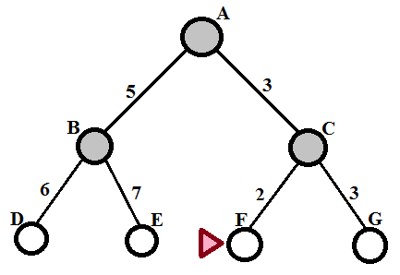
Uniform-Cost Search
‹#›

Slide 38
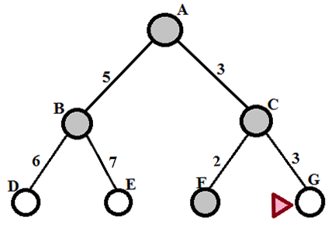
Uniform-Cost Search
‹#›

Slide 39
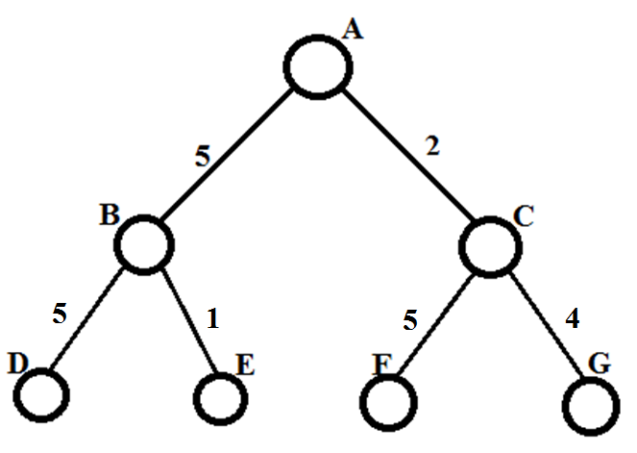
Uniform-Cost Search
Let us consider the another search tree, where A and G are the initial and goal node, respectively.
‹#›

Slide 40
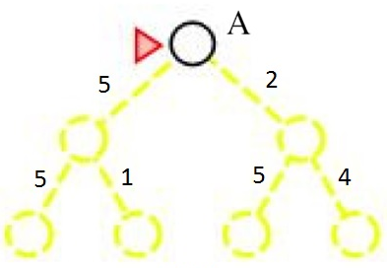
Uniform-Cost Search
‹#›

Slide 41
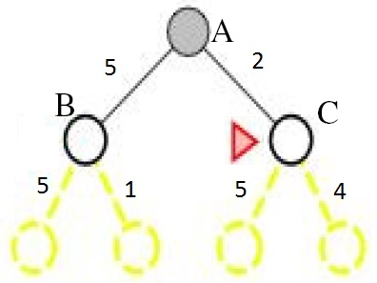
Uniform-Cost Search
‹#›

Slide 42
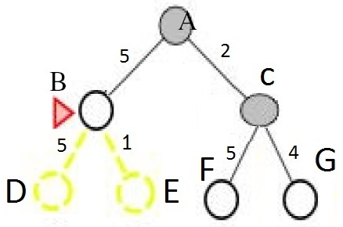
Uniform-Cost Search
‹#›

Slide 43
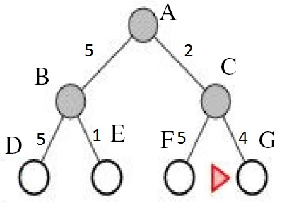
Uniform-Cost Search
‹#›

Slide 44
Uniform-Cost Search
Completeness:
  YES, if step-cost > some small positive constant ε
Optimality:
  nodes expanded in order of increasing path cost
  YES, if complete
Time and space complexity:
  Uniform-cost search is guided by path costs rather than depths, so its complexity cannot easily be characterized in terms of b and d.
  Instead, assume C* is the cost of the optimal solution
  Assume that every action costs at least ε
  Worst-case: O(b^{C*/ε})
‹#›

Slide 45
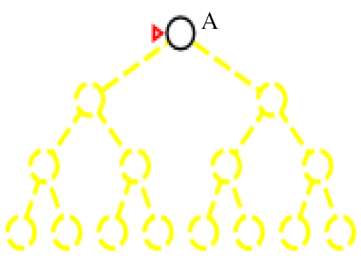
Depth-First Search
Expand deepest unexpanded node
Implementation: fringe is a LIFO queue (= stack)
‹#›

Slide 46
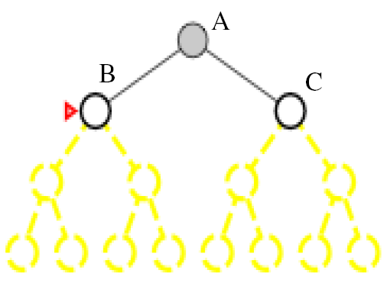
Depth-First Search
Expand deepest unexpanded node
Implementation: fringe is a LIFO queue (= stack)
‹#›

Slide 47
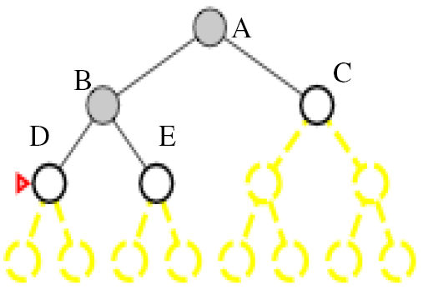
Depth-First Search
Expand deepest unexpanded node
Implementation: fringe is a LIFO queue (= stack)
‹#›

Slide 48
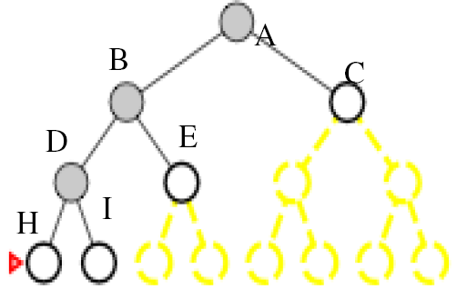
Depth-First Search
Expand deepest unexpanded node
Implementation: fringe is a LIFO queue (= stack)
‹#›

Slide 49
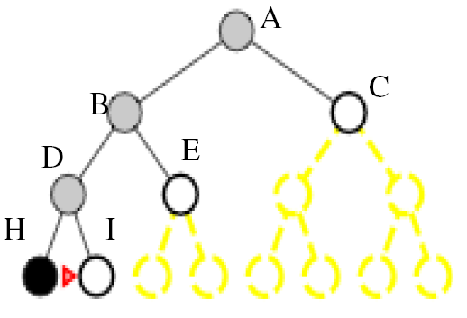
Depth-First Search
Expand deepest unexpanded node
Implementation: fringe is a LIFO queue (= stack)
‹#›

Slide 50
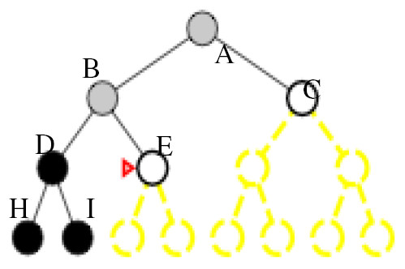
Depth-First Search
Expand deepest unexpanded node
Implementation: fringe is a LIFO queue (= stack)
‹#›

Slide 51
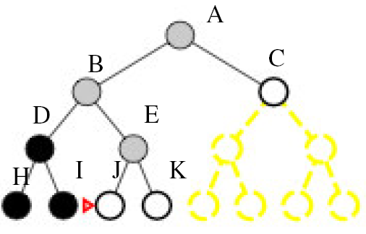
Depth-First Search
Expand deepest unexpanded node
Implementation: fringe is a LIFO queue (= stack)
‹#›

Slide 52
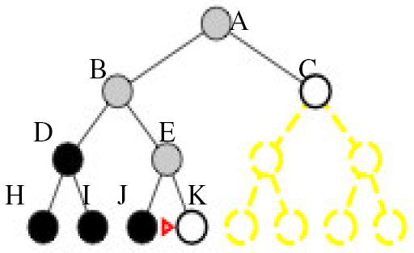
Depth-First Search
Expand deepest unexpanded node
Implementation: fringe is a LIFO queue (= stack)
‹#›

Slide 53
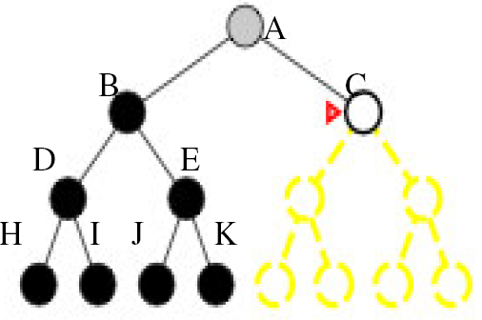
Depth-First Search
Expand deepest unexpanded node
Implementation: fringe is a LIFO queue (= stack)
‹#›

Slide 54
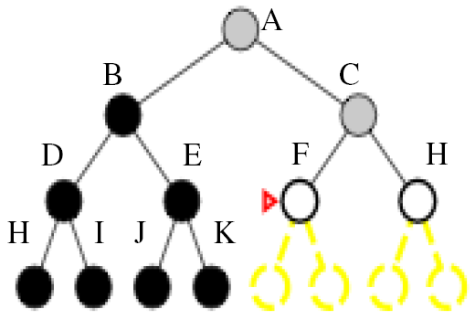
Depth-First Search
Expand deepest unexpanded node
Implementation: fringe is a LIFO queue (= stack)
‹#›

Slide 55
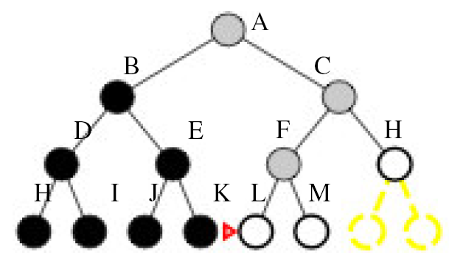
Depth-First Search
Expand deepest unexpanded node
Implementation: fringe is a LIFO queue (= stack)
‹#›

Slide 56
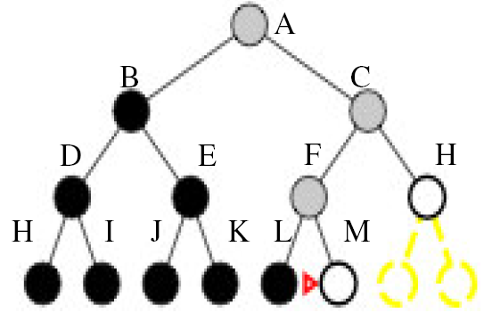
Depth-First Search
Expand deepest unexpanded node
Implementation: fringe is a LIFO queue (= stack)
‹#›

Slide 57
DF-Search: Evaluation
Completeness:
  Is a solution always found if one exists?
  No (unless search space is finite and no loops are possible)
Optimality:
  Is the least-cost solution always found?
  No
‹#›

Slide 58
DF-Search: Evaluation
Time complexity: O(b^{m})
In general, time is terrible if m (maximal depth) is much larger than d (depth of shallowest solution)
  But if there exist many solutions then faster than BF-search
Space complexity: O(bm)
  Backtracking search uses even less memory (one successor instead of all b)
‹#›

Slide 59
Depth-Limited Search
DF-search with depth limit l
  i.e. nodes at depth l have no successors
  Problem knowledge can be used
Solves the infinite-path problem
If l < d then incompleteness results
Time complexity: O(b^{l})
Space complexity: O(bl)
Depth-first search can be viewed as a special case of depth-limited search with l = ∞.
‹#›

Slide 60

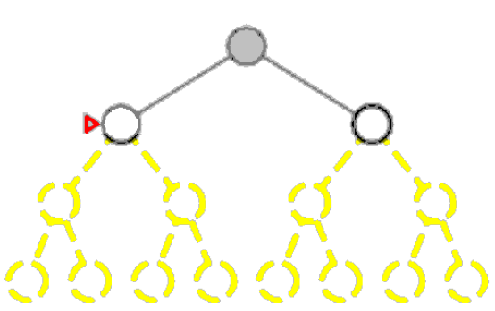
Depth-Limited Search with l = 2
‹#›

Slide 61

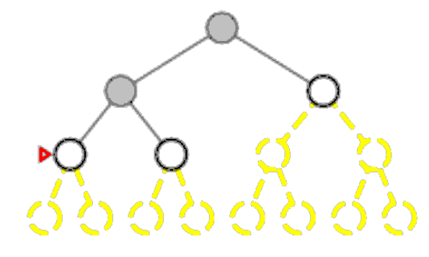
Depth-Limited Search with l = 2
‹#›

Slide 62
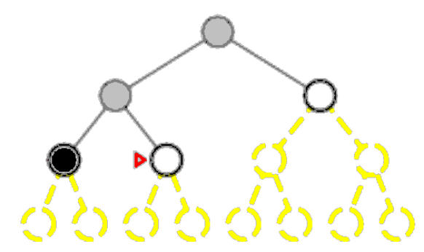
Depth-Limited Search with l = 2
‹#›

Slide 63
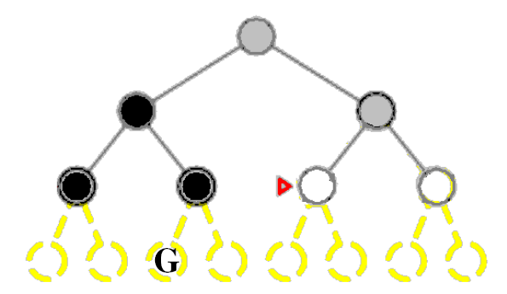
Depth-Limited Search with l = 2
‹#›

Slide 64
Depth-Limited Search
DF-search with depth limit l
  i.e. nodes at depth l have no successors
  Problem knowledge can be used
Sometimes, depth limits can be based on knowledge of the problem.
For example, on the map of Romania there are 20 cities.
Therefore, we know that if there is a solution, it must be of length 19 at the longest, so l = 19 is a possible choice.
‹#›

Slide 65
Depth-Limited Search
But in fact if we studied the map carefully, we would discover that any city can be reached from any other city in at most 9 steps.
This number, known as the diameter of the state space, gives us a better depth limit, which leads to a more efficient depth-limited search.
Diameter of state space is the maximum distance from one state to another in the state space.
For most problems, however, we will not know a good depth limit until we have solved the problem.
‹#›

Slide 66
Iterative Deepening Search
A general strategy to find best depth limit l
  Goal is found at depth d, the depth of the shallowest goal-node
  Often used in combination with DF-search
Combines benefits of DF- and BF-search
Like depth-first search, its memory requirements are very modest: O(bd) to be precise.
Like breadth-first search, it is complete when the branching factor is finite and optimal when the path cost is a nondecreasing function of the depth of the node.
‹#›

Slide 67
Iterative Deepening Search
Iterative deepening search may seem wasteful, because states are generated multiple times.
It turns out this is not very costly.
The reason is that in a search tree with the same (or nearly the same) branching factor at each level, most of the nodes are in the bottom level, so it does not matter much that the upper levels are generated multiple times.
‹#›

Slide 68
Iterative Deepening Search
In an iterative deepening search, the nodes on the bottom level (depth d) are generated once, those on the next to bottom level are generated twice, and so on, up to the children of the root, which are generated d times.
So the total number of nodes generated is
N(IDS) = d.b + (d - 1).b² + ...+ 1.b^{d} = O(b^{d})
We can compare this to the nodes generated by a breadth-first search:
N(BFS) = b + b² + ...+ b^{d} + (b^{d+1} – b)= O(b^{d+1})
Notice that breadth-first search generates some nodes at depth d+1, whereas iterative deepening does not.
The result is that iterative deepening is actually faster than breadth-first search, despite the repeated generation of states.
‹#›

Slide 69
Iterative Deepening Search
For example, if b = 10 and d = 5,
‹#›

Slide 70
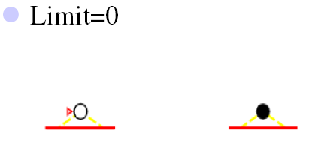
ID-Search: Example
‹#›

Slide 71
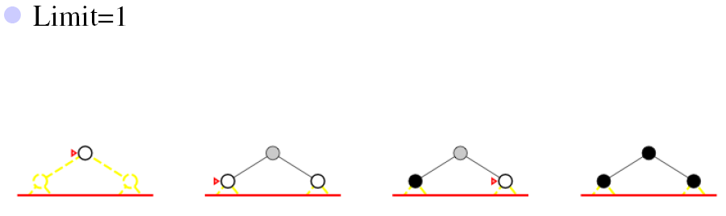
ID-Search: Example
‹#›

Slide 72
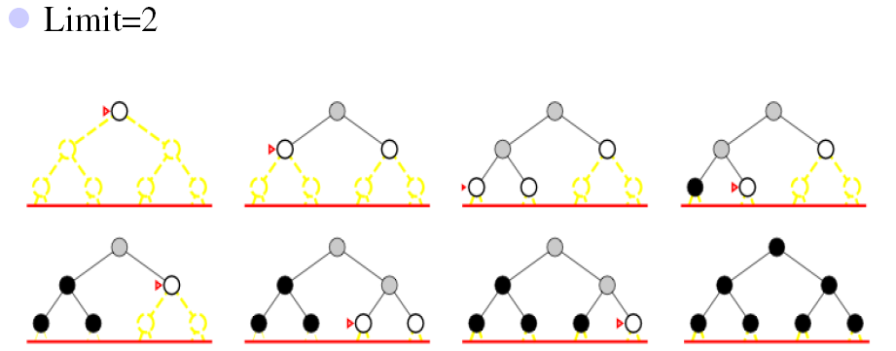
ID-Search: Example
‹#›

Slide 73
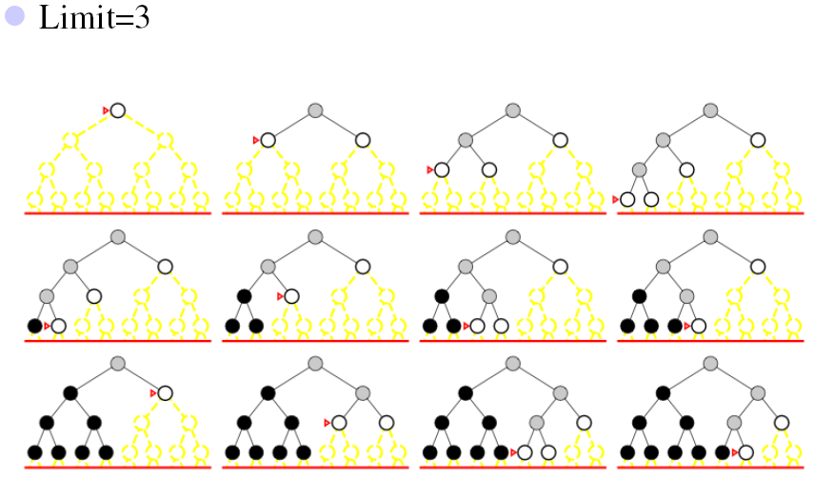
ID-Search: Example
‹#›

Slide 74
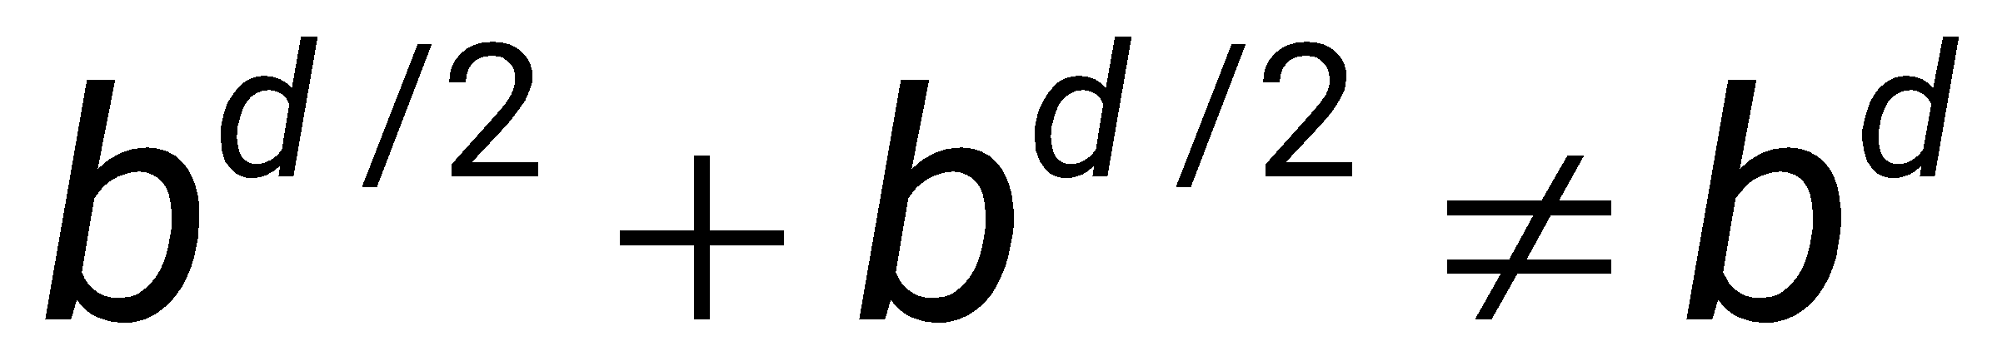
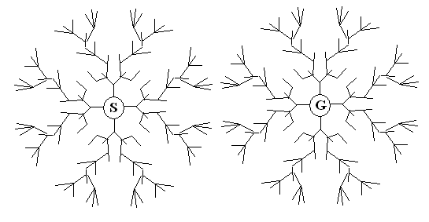
Bidirectional Search
Two simultaneous searches run from start and goal.
  Motivation:
  One forward from the initial state
  Other backward from goal
  Stops when the two searches meet in the middle
    Check whether the node belongs to the other fringe before expansion
‹#›

Slide 75
Bidirectional Search
Time complexity: O(b^{d/2})
Space complexity: O(b^{d/2})
  This space complexity is the most significant weakness of bidirectional search.
Completeness and Optimality: Yes
  If step costs are uniform
  If both searches are breadth-first search.
‹#›

Slide 76
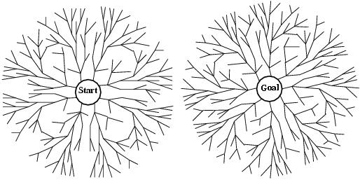
Bidirectional Search
The reduction in time complexity makes bidirectional search attractive, but how do we search backwards?
The predecessor of each node should be efficiently computable.
  When actions are easily reversible.

Slide 77
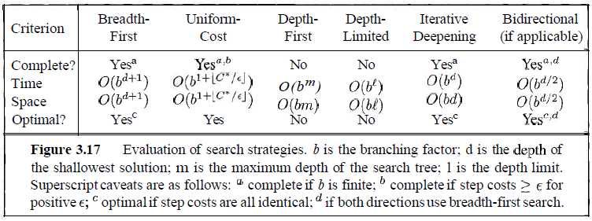
Summary of Algorithms
‹#›

